Slide 1
QR Code reading
Master’s thesis, Matija Bačić
Faculty of Electrical Engineering and Computing, 2021/2022

Slide 2
QR code capacity
Data type | Maximum capacity using version 40-L
Numeric | 7089
Alphanumeric | 4296
8-bit | 2953
Kanji | 1817

Slide 3
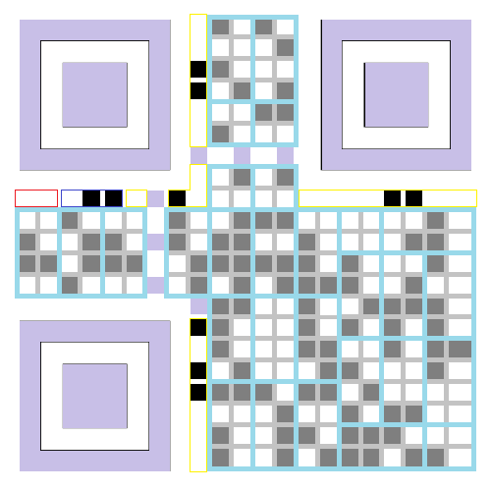
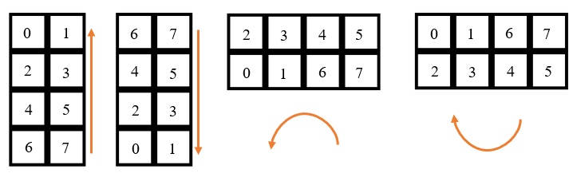
QR Code structure

Slide 4
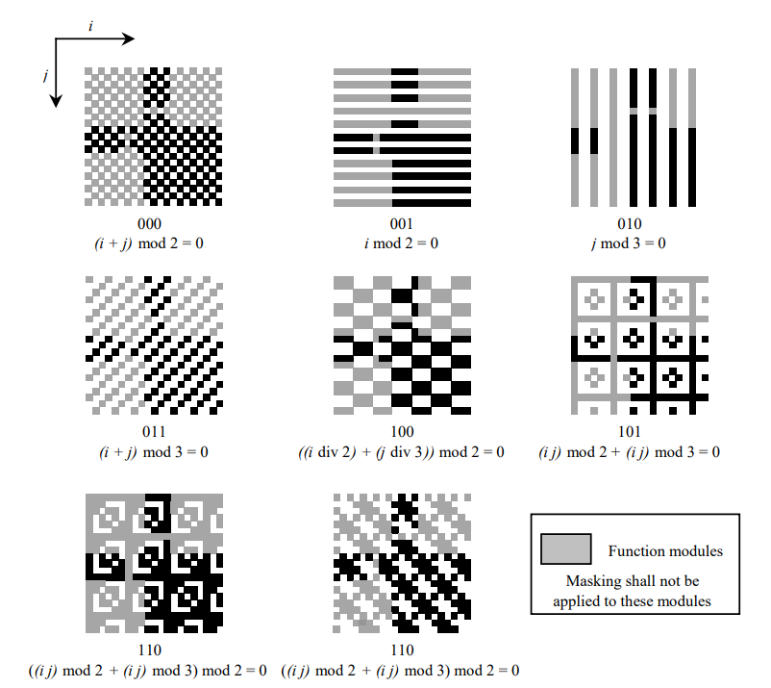

Slide 5
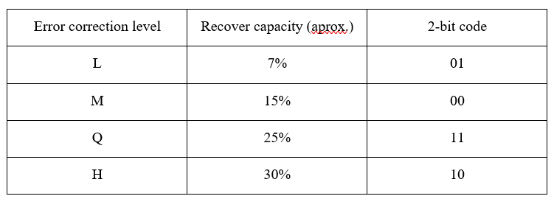
Error correction levels

Slide 6
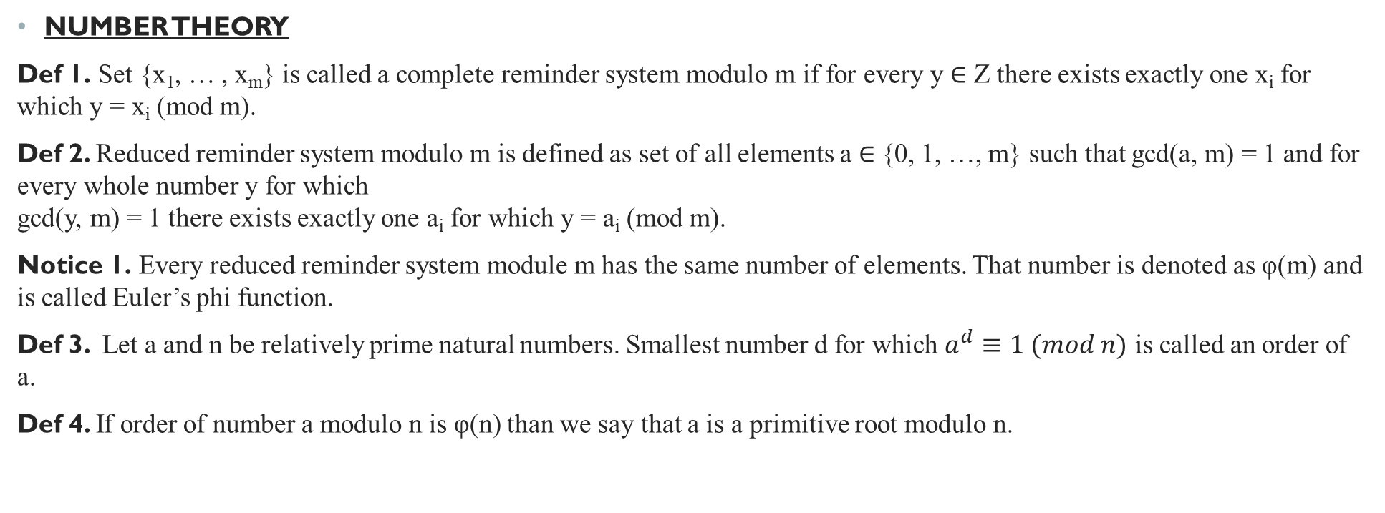
Abstract algebra
NUMBER THEORY
Def 1. Set {x₁, … , x_{m}} is called a complete reminder system modulo m if for every y ∈ Z there exists exactly one x_{i} for which y = x_{i} (mod m).
Def 2. Reduced reminder system modulo m is defined as set of all elements a ∈ {0, 1, …, m} such that gcd(a, m) = 1 and for every whole number y for which gcd(y, m) = 1 there exists exactly one a_{i} for which y = a_{i} (mod m).
Notice 1. Every reduced reminder system module m has the same number of elements. That number is denoted as φ(m) and is called Euler’s phi function.
Def 3. Let a and n be relatively prime natural numbers. Smallest number d for which $a^{d}≡1 (mod n)$ is called an order of a.
Def 4. If order of number a modulo n is φ(n) than we say that a is a primitive root modulo n.

Slide 7
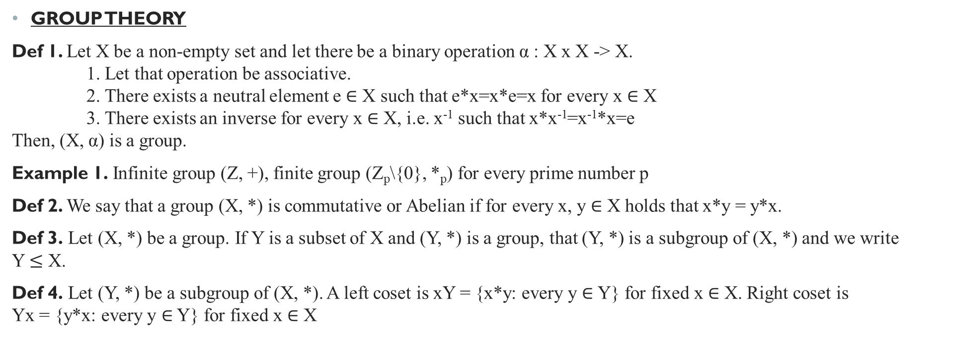
Abstract algebra
GROUP THEORY
Def 1. Let X be a non-empty set and let there be a binary operation α : X x X -> X. 1. Let that operation be associative. 2. There exists a neutral element e ∈ X such that e*x=x*e=x for every x ∈ X 3. There exists an inverse for every x ∈ X, i.e. x⁻¹ such that x*x⁻¹=x⁻¹*x=e Then, (X, α) is a group.
Example 1. Infinite group (Z, +), finite group (Z_{p}\{0}, *_{p}) for every prime number p
Def 2. We say that a group (X, *) is commutative or Abelian if for every x, y ∈ X holds that x*y = y*x.
Def 3. Let (X, *) be a group. If Y is a subset of X and (Y, *) is a group, that (Y, *) is a subgroup of (X, *) and we write Y $≤$ X.
Def 4. Let (Y, *) be a subgroup of (X, *). A left coset is xY = {x*y: every y ∈ Y} for fixed x ∈ X. Right coset is Yx = {y*x: every y ∈ Y} for fixed x ∈ X

Slide 8
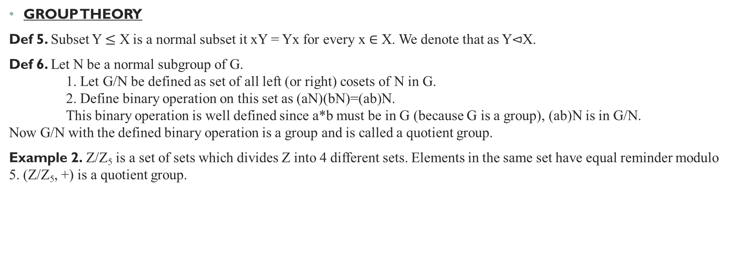
Abstract algebra
GROUP THEORY
Def 5. Subset Y $≤$ X is a normal subset it xY = Yx for every x ∈ X. We denote that as Y$⊲$X.
Def 6. Let N be a normal subgroup of G. 1. Let G/N be defined as set of all left (or right) cosets of N in G. 2. Define binary operation on this set as (aN)(bN)=(ab)N. This binary operation is well defined since a*b must be in G (because G is a group), (ab)N is in G/N. Now G/N with the defined binary operation is a group and is called a quotient group.
Example 2. Z/Z₅ is a set of sets which divides Z into 4 different sets. Elements in the same set have equal reminder modulo 5. (Z/Z₅, +) is a quotient group.

Slide 9
Abstract algebra
RING THEORY
Def 1. A ring is defined as (R, +, *) where 1.(R, +) is an Abelian group 2. (R, *) is a semigroup 3. distributivity holds: x*(y+z) = x*y+x*z and (x+y)*z = x*z + y*z for every x,y,z from R.
Def 2. Polynomial ring (written as R[t]) is defined as every polynomial whose coefficients are from R and they form a ring (R, +, *).
Subring <-> subgroup
Normal subgroup <-> ideal
Quotient group <-> Quotient rings
Def 3. Integral domain is a ring in which there are no divisors of 0. I.e. if x*y = 0 then x=0 or y=0.
Theorem 1. If and only if m is a prime number, Z_{m} is an integral domain.

Slide 10
Abstract algebra
GALOIS FIELD THEORY
Def 1. A field is a commutative integral domain in which every non-zero member has an inverse with respect to multiplication operation. In other words, (F, +, *) is a field if:
(F, +) is an Abelian group
(F, *) is an Abelian group
Distributivity: x*(y+z) = x*y+x*z and (x+y)*z = x*z + y*z for ∀x,y,z ∈ F
Theorem 1. Every finite commutative integral domain is a field.
Def 2. Galois field is a finite field with q elements (F_{q} or GF(q)). If p is prime, F_{p} is Z/pZ. Also, exists for q=p^{n} elements.
Theorem 2. If F_{q} is a field with q=p^{n} elements, then every member of that field satisfies equation X^{q}-X=0. In other words, set of polynomial decomposition of X^{q}-X=0 over F_{p} is the field F_{q}.

Slide 11
Abstract algebra
GALOIS FIELD THEORY
Example 1. (Constructing F₉) As F₃[t]/(P(t))
0, 1, 2, t, t + 1, t + 2, 2t, 2t + 1, 2t + 2
P(t) ∈ {t²+1, t²+t+2, t²+2t+2}

Slide 12
Abstract algebra
GALOIS FIELD THEORY
Example 2. (Constructing F₄ with primitive polynomial) P(x) = x² + x + 1
Powers of α | As polynomial | As power of 2
0 | 0 | - inf
1 | 1 | 1
α | α | 2
α² | α + 1 | 3
α³ | αα² = α(α + 1) = α² + α = α + 1 + α = 2α + 1 = 1 | 1
α⁴ | (α + 1)(α + 1) = α² + α + α + 1 = α | 2

Slide 13
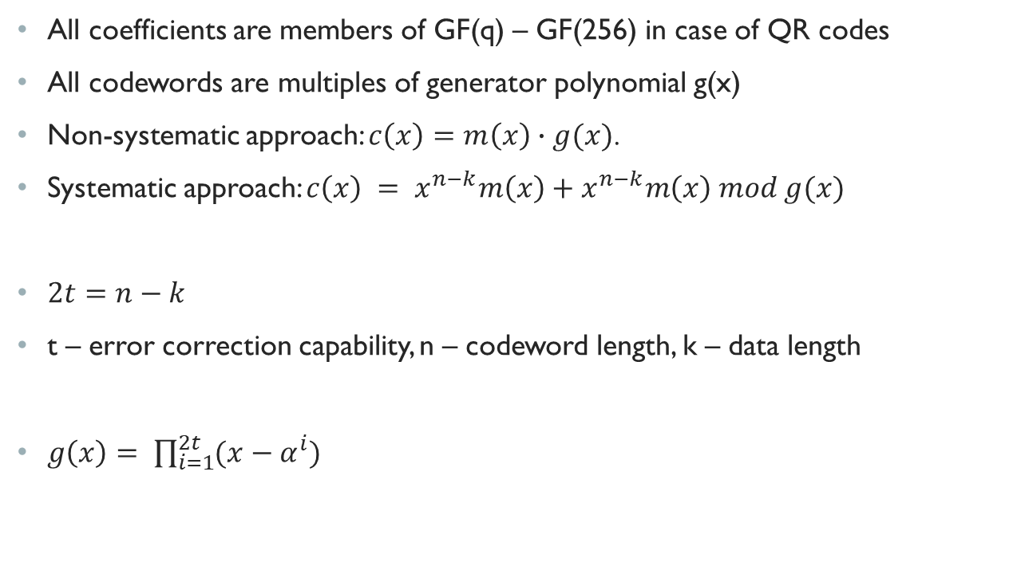
Reed-Solomon coding
All coefficients are members of GF(q) – GF(256) in case of QR codes
All codewords are multiples of generator polynomial g(x)
Non-systematic approach: $c\left(x\right)=m\left(x\right)∙g(x)$.
Systematic approach: $c\left(x\right) = x^{n−k}m\left(x\right)+x^{n−k}m\left(x\right) mod g(x)$
$2t=n−k$
t – error correction capability, n – codeword length, k – data length
$g\left(x\right)= \prod_{i=1}^{2t}{(x−α^{i})}$

Slide 14

REED–Solomon coding Decoding steps
Step 1. Syndrome calculation
$$S_{i}=R\left(α^{i}\right), for i= 1, …, 2t$$

Slide 15
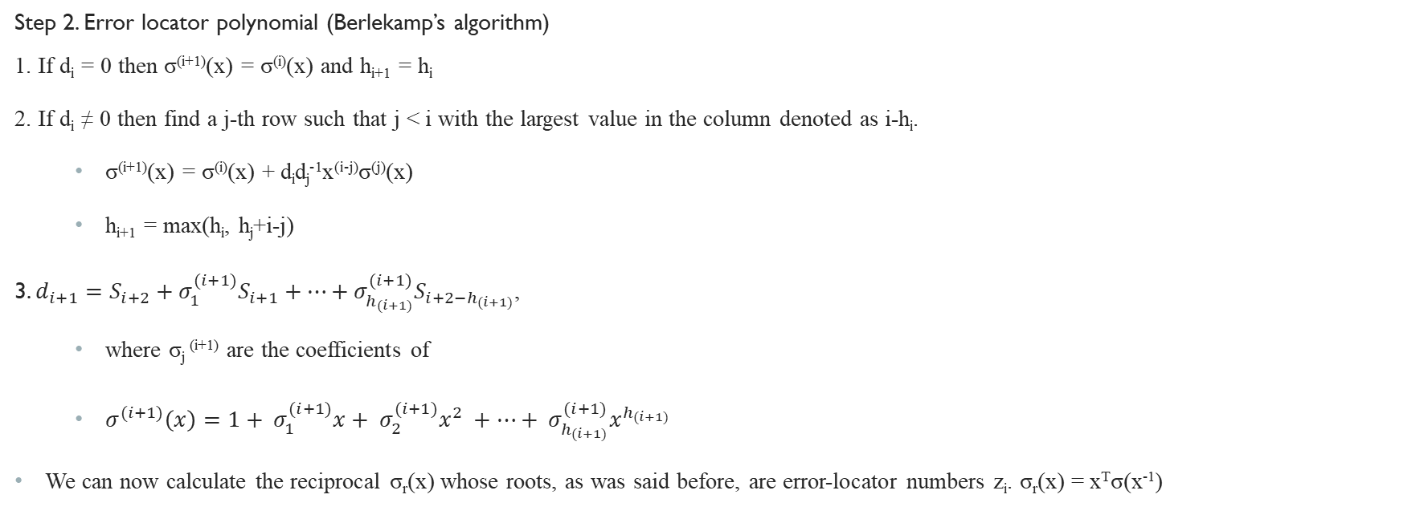
REED–Solomon coding Decoding steps
Step 2. Error locator polynomial (Berlekamp’s algorithm)
1. If d_{i} = 0 then σ^{(i+1)}(x) = σ^{(i)}(x) and h_{i+1} = h_{i}
2. If d_{i} ≠ 0 then find a j-th row such that j < i with the largest value in the column denoted as i-h_{i}.
σ^{(i+1)}(x) = σ^{(i)}(x) + d_{i}d_{j}⁻¹x^{(i-j)}σ^{(j)}(x)
h_{i+1} = max(h_{i}, h_{j}+i-j)
3. $d_{i+1}=S_{i+2}+σ_{1}^{(i+1)}S_{i+1}+…+σ_{h_{(i+1)}}^{(i+1)}S_{{i+2−h}_{(i+1)}}$,
where σ_{j} ^{(i+1)} are the coefficients of
$σ^{(i+1)}\left(x\right)=1+ σ_{1}^{(i+1)}x+ σ_{2}^{(i+1)}x^{2} +…+ σ_{h_{(i+1)}}^{(i+1)}x^{h_{(i+1)}}$
We can now calculate the reciprocal σ_{r}(x) whose roots, as was said before, are error-locator numbers z_{i}. σ_{r}(x) = x^{T}σ(x⁻¹)
i | σ^{(i)}(x) | d_{i} | h_{i} | i-h_{i}
-1 | 1 | 1 | 0 | -1
0 | 1 | S₁ | 0 | 0
1 | … | … | … | …
… | … | … | … | …
2t | σ(x) | - | - | -

Slide 16

REED–Solomon coding Decoding steps
Step 3. Error locations
$$x_{i}=X^{\log_{α}{z_{i}}}$$
where zi is the i-th root of reciprocal of error locator polynomial. We can find them by Chien search (brute force)

Slide 17

REED–Solomon coding Decoding steps
Step 4. Error values
$$S_{i}=\sum_{j=1}^{T}{y_{j}z_{j}^{i}}$$

Slide 18

REED–Solomon coding Decoding steps
Step 5. Estimate of error
$$E′\left(x\right)=\sum_{i=1}^{T}{y_{i}x_{i}}$$
$$C^{′}\left(x\right)=R\left(x\right)+E′(x)$$

